Slide 1
CAREERS:
What people do…
…to make money...
…a living…
…a life

Slide 2
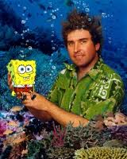
Do you know who this is?

Slide 3
Stephen McDannell Hillenburg
Creator of SpongeBob
As a child he loved the films of Jacques Cousteau,
so Stephen Hillenburg earned a degree in natural-resource planning and interpretation, with an emphasis in marine resources from Humboldt State University (Arcata, Calif.) in 1984. For three years he taught marine biology at the Orange County Marine Institute (now known as the Orange County Ocean Institute), in Dana Point, California. He had always enjoyed drawing and painting, so he pursued a master's-degree program in experimental animation at the California Institute of the Arts, in Valencia. All these experiences came together to create SpongeBob SquarePants.
http://www.imdb.com/name/nm0384864/bio

Slide 4

I think you may know who this is.

Slide 5
Yes, it is J.K. Rowling, the writer…who created the Harry Potter series.
Harry Potter & the Philosopher’s Stone…. was first published by Bloomsbury Children’s Books in June 1997, under the name J.K. Rowling.
The “K”, for Kathleen, her paternal grandmother’s name was added at her publisher’s request who thought that a woman’s name would not appeal to the target audience of young boys.
http://www.jkrowling.com/en_GB/#/about-jk-rowling

Slide 6
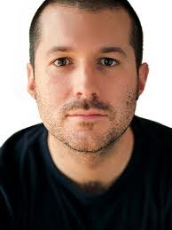
Do you know who this is?

Slide 7

His name is Jonathan Ive.
He is the Senior Vice-President of Design, Apple.
The man next to him is the founder of Apple, Steve Jobs.

Slide 8
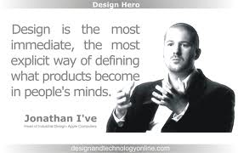
Now you know why it is called and IPOD… or an Itouch… or an Ipad…the “I” comes from Jonathan’s last name…Ive.

Slide 9
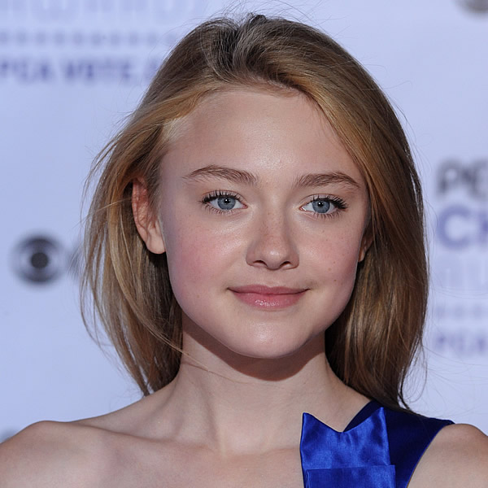
Do you know who this young lady is?
http://uk.askmen.com/top_10/celebrity/top-10-hollywood-agents_10.html

Slide 10

If you said , “Dakota Fanning, actress”,
you are correct!
I doubt you know who this lady is, but she is a very important person in Dakota’s life…and it is NOT her mom.
Take a guess….

Slide 11
Her name is Cindy Osbrink. She is Dakota’s agent!
When Cindy Osbrink’s children started acting, she decided that she’d represent them herself and she wound up founding the Osbrink Agency. Known for its stranglehold on child actors, the agency represents both kids in Adam Sandler's Bedtime Stories, Hannah Montana’s love interest, Lucas Till, and three of the kids in Robert Rodriguez's upcoming film Shorts. Not to mention the Fanning sisters, whom Cindy personally represents herself.
http://uk.askmen.com/top_10/celebrity/top-10-hollywood-agents_10.html

Slide 12
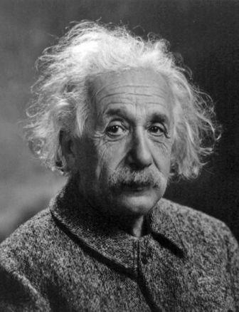
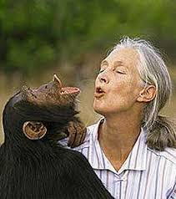
What do these two people have in common?

Slide 13
They are…and were SCIENTISTS!

Slide 14
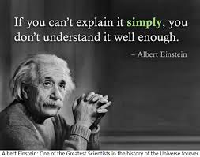
This is Albert Einstein(1879-1955).
He was the most important physicist of the 1900's and one of the greatest and most famous scientists of all time. He was a theoretical physicist, a scientist who creates and develops theories of matter and energy. Einstein's greatness arose from the fact that his theories solved fundamental problems and presented new ideas. Much of his fame came from the fact that several of those ideas were strange and hard to understand—but proved true.
Howard, Don. "Einstein, Albert." World Book Student. World Book, 2013. Web. 16 Apr. 2013.

Slide 15
This is Jane Goodall.
She is an English zoologist who studies the behavior of animals. She became known for her studies of chimpanzees. She has also worked to ensure that chimps survive in the wild. Goodall began her research in 1960 at what is now Gombe Stream National Park in northwestern Tanzania.
She won the trust of many chimpanzees through daily contact with them.
Susman, Randall L. "Goodall, Jane." World Book Student. World Book, 2013. Web. 16 Apr. 2013.

Slide 16
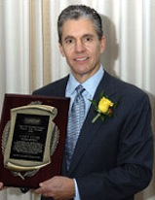
Bet you don’t know who he is!

Slide 17
His name is Casey Close.
He is a sports agent.
Agency: CAA
Top current deals:
$45M to $125M contract for Derek Jeter (New York Yankees)
$125M contract for Ryan Howard (Philadelphia Phillies)
$55M contract for Gil Meche (Kansas City Royals)
$33.5M contract for Michael Cuddyer (Minnesota Twins)
Top deals value: $259-329M
Casey Close is best known as Derek Jeter's agent. In 2007, Close joined the exodus from sports giant IMG to celebrity agency CAA, where he now heads the growing baseball division. His current negotiations between Jeter and Yankees are the most talked about of the offseason.
http://deadspin.com/5701614/the-12-best-sports-agents-in-the-world

Slide 18
There are a bunch of things you can do.
You may have a TON of interests…and ideas…and dreams.
That’s all great, but please remember…

Slide 19
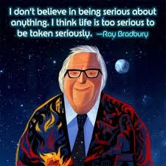
anitasnotebook.com

Slide 20
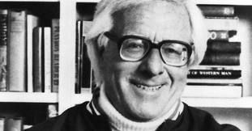
No matter what you do in life,
remember these words from Ray Bradbury, a famous writer:
The answer to all writing, to any career for that matter, is love.
Quote: http://www.brainyquote.com/quotes/quotes/r/raybradbur447445.html#BGPopEcYk3HOTHjy.99

